Slide 1
AD Utility
This script is a key tool in our utility suite, designed to streamline querying of multiple accounts within an Active Directory group, thereby fostering enhanced operational efficiency and accuracy.

Slide 2
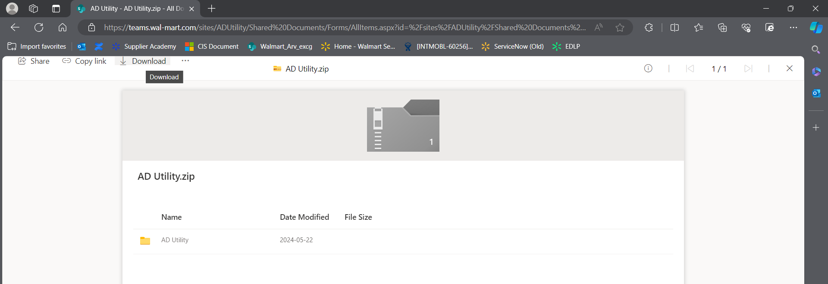
Preparation
1. Start by downloading the AD utility file from the link
Download AD Utility

Slide 3
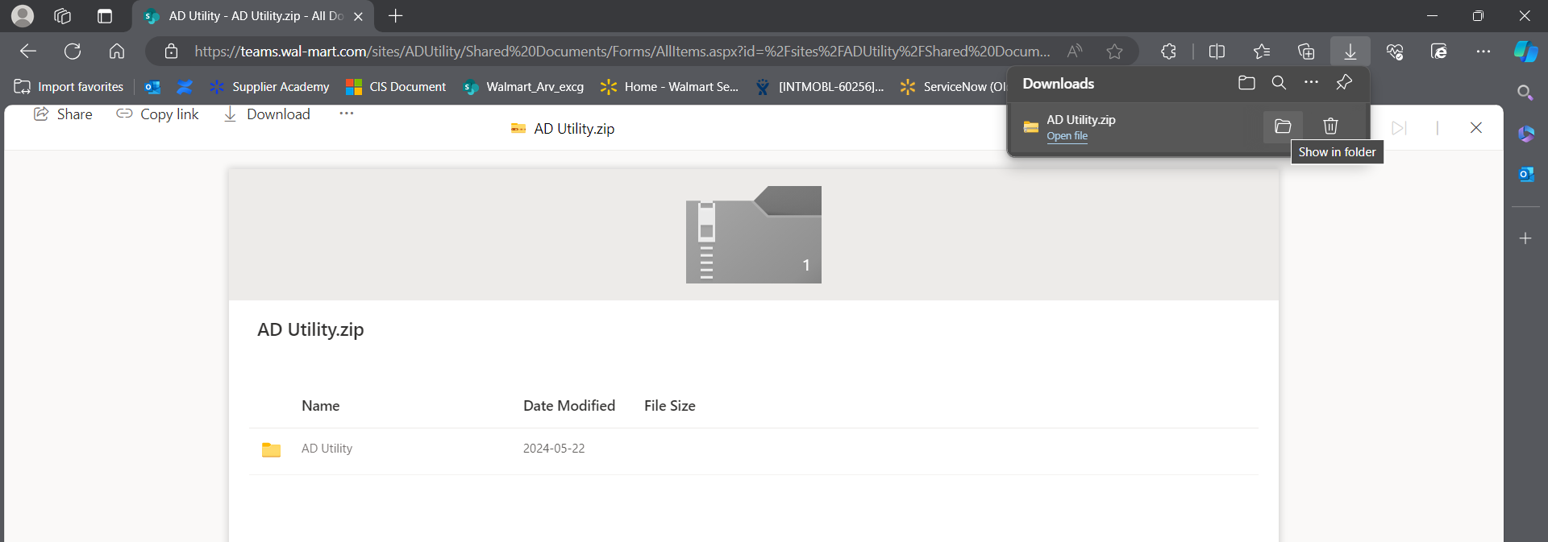
Preparation
2. Click on ‘Show in Folder’ that takes you to the download folder.

Slide 4
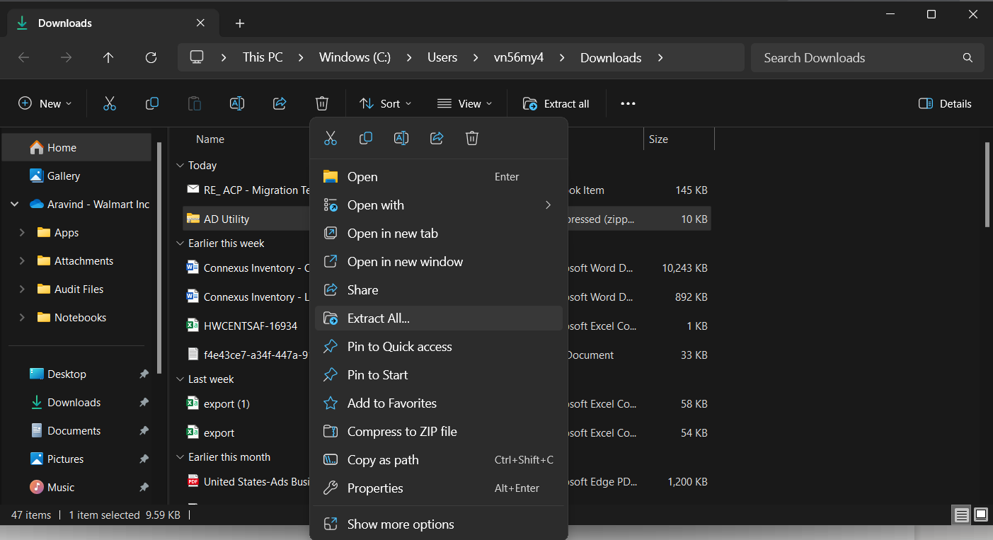
Preparation
3. Once downloaded, extract the contents of the zip file to the same location.

Slide 5
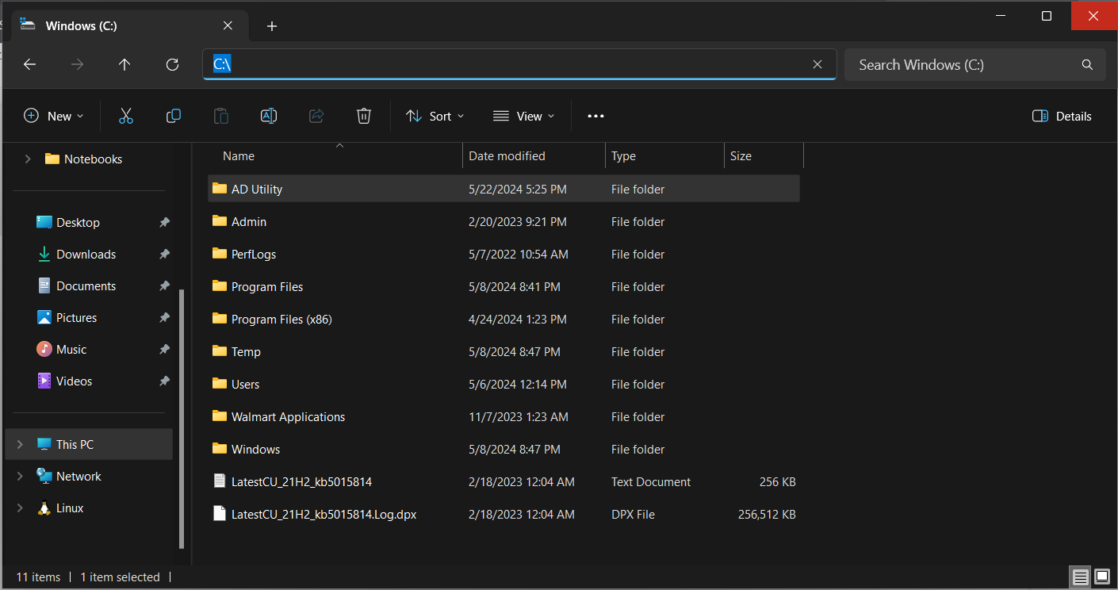
Preparation
4. Move the Extracted AD Utility folder to the Local Disk ‘C:\’ .

Slide 6
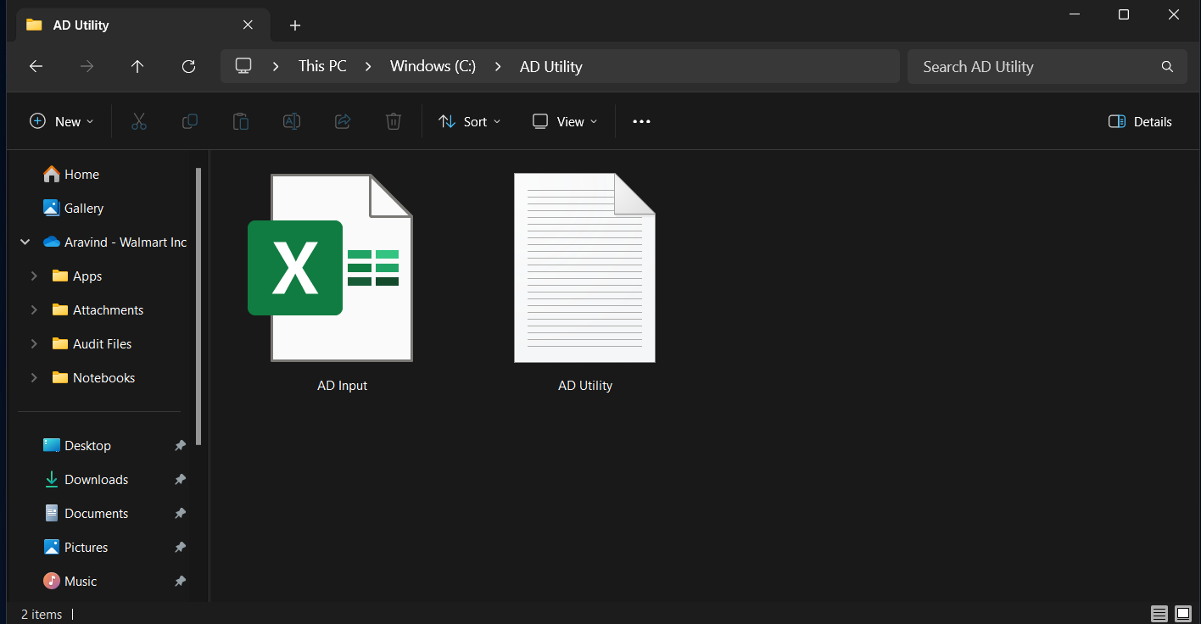
Source
5. Inside the extracted zip file, you will find two files: ‘AD Input.xlsx’ and 'AD Utility.vbs’.
'AD Utility.vbs’ – Script that executes the AD Utility query.
‘AD Input.xlsx’, Contains the inputs of AD Groups, Domain name and accounts that needs to queried.

Slide 7
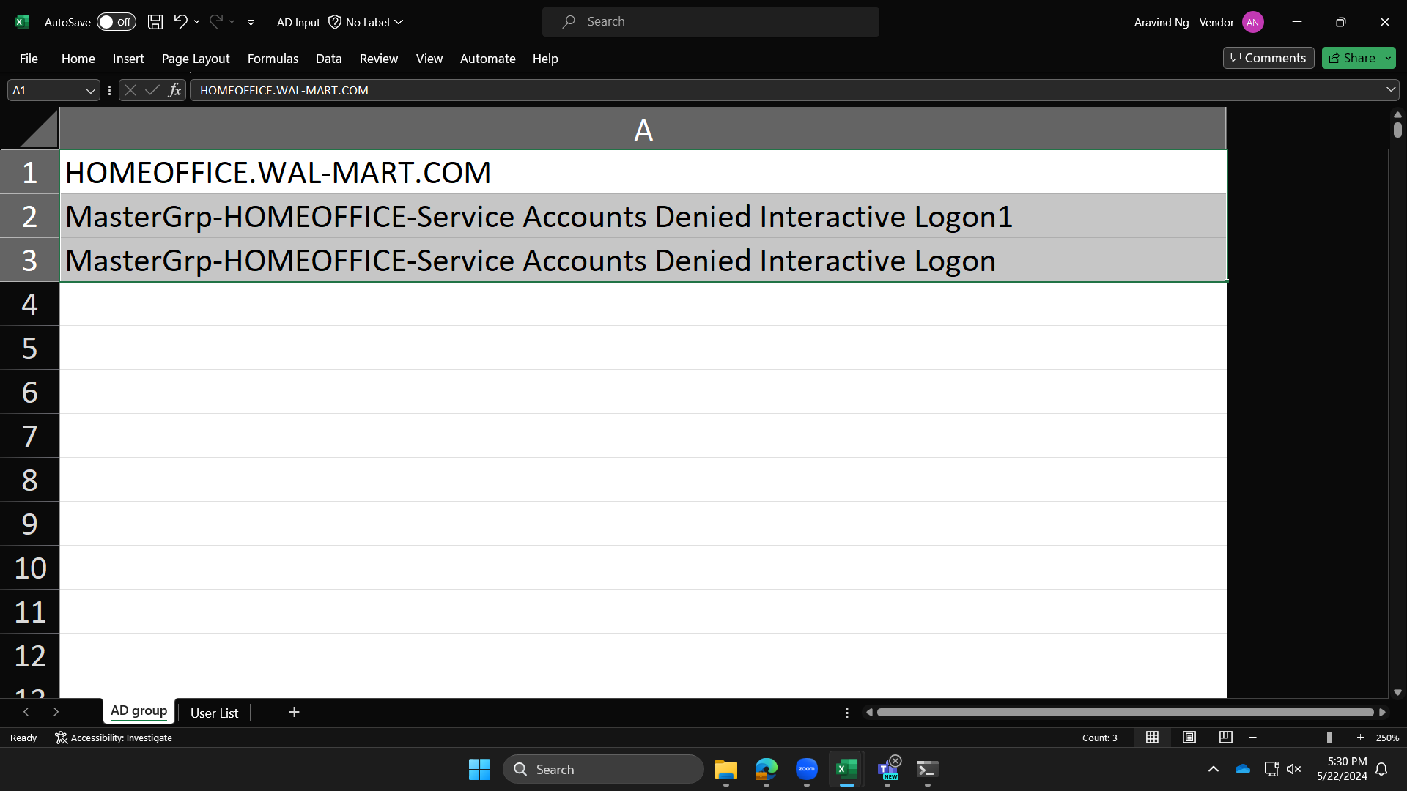
Input
6. In the file ‘AD Input.xlsx’ there are 2 tabs namely ‘AD group’ and ‘User List’. Open tab ‘AD group’ within the file and input 1 Domain name (Cell A1) and 2 AD Group (Cell A2 ,A3) only for which you would like to execute the query.
Input
Cell A1 : Domain Name,
Cell A2 & A3 : AD Group
Note :
Please make sure there are no spaces, punctuation marks at the beginning or the end of any input fields. Refrain from modifying the AD group names by removing spaces, hyphens or underscore.
AD Groups and Domain names must be inputted in the ‘AD group’ tab only, within the mentioned cells.

Slide 8
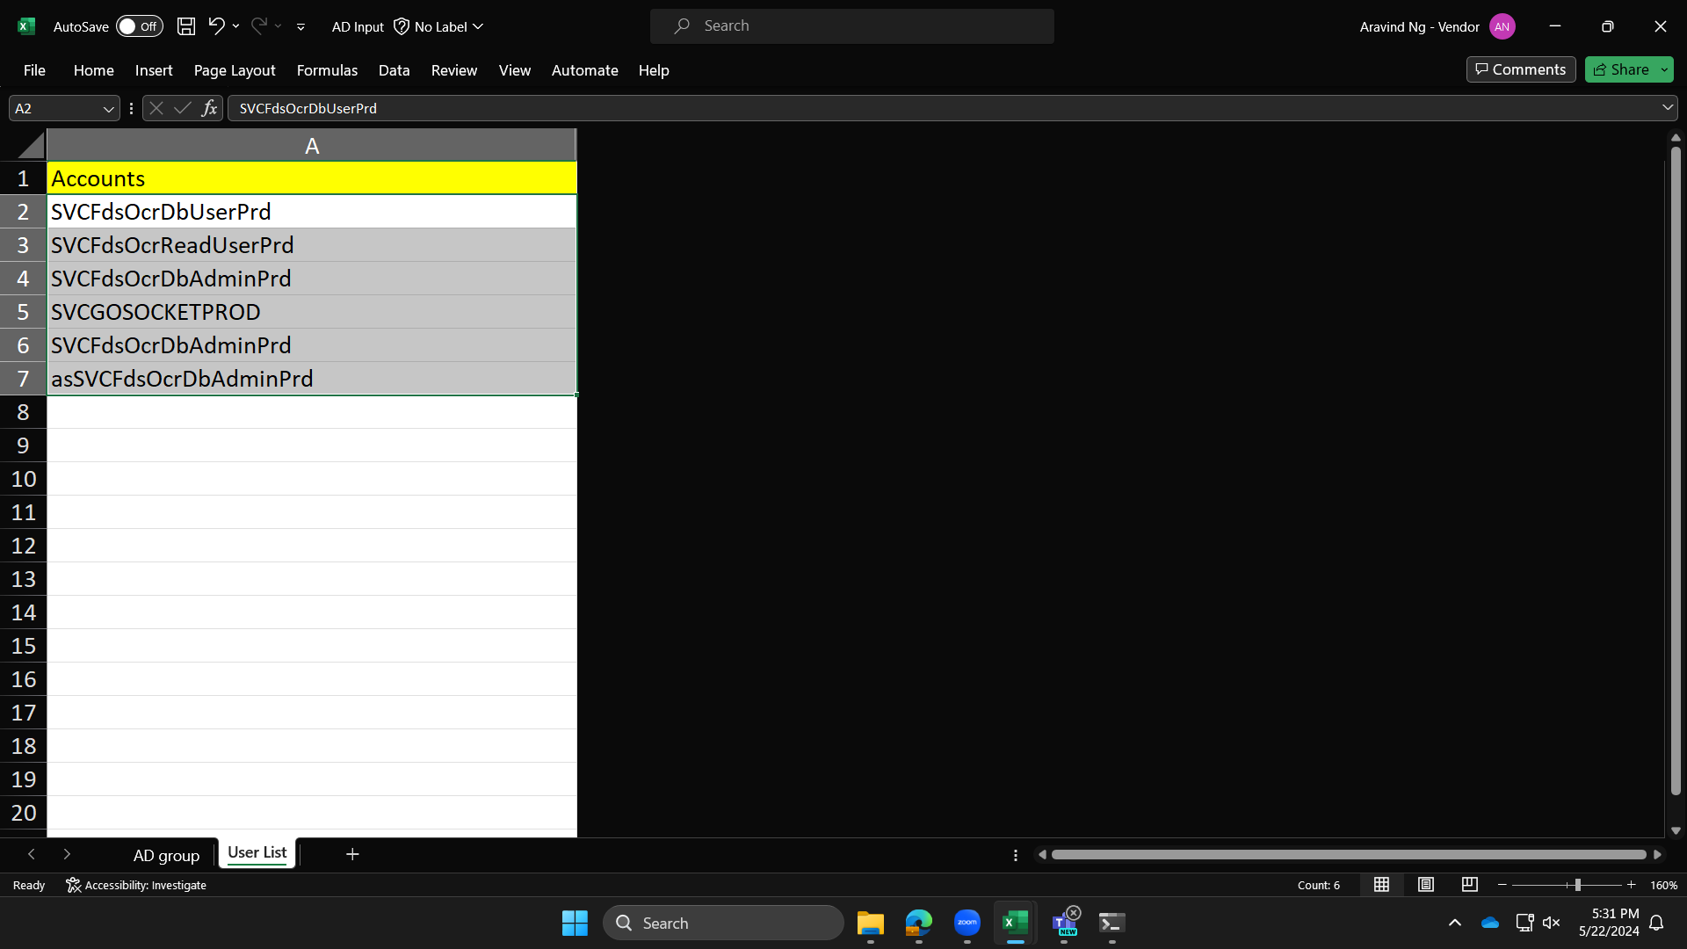
Input
7. Open tab ‘User List’ within the ‘AD Input.xlsx' file and input all the Accounts you want to query within the AD group.
Inputting of Accounts must start from Cell A2. There are no restrictions to number of Accounts that this script can test.
Note :
Please make sure there are no spaces, punctuation marks at the beginning or the end of any input fields. Refrain from modifying the Account names by removing spaces, hyphens or underscore within.
Do not input multiple accounts on the same line separated by spaces; each account name must be on its own cell.
Once the inputs are made, click on save. Do not close the file.
During Save, Do not change name of the file.
Do not make modification to the ‘AD Input.xlsx’ during script run.
Account names must be inputted in the ‘User List’ tab only, within the mentioned cells.

Slide 9
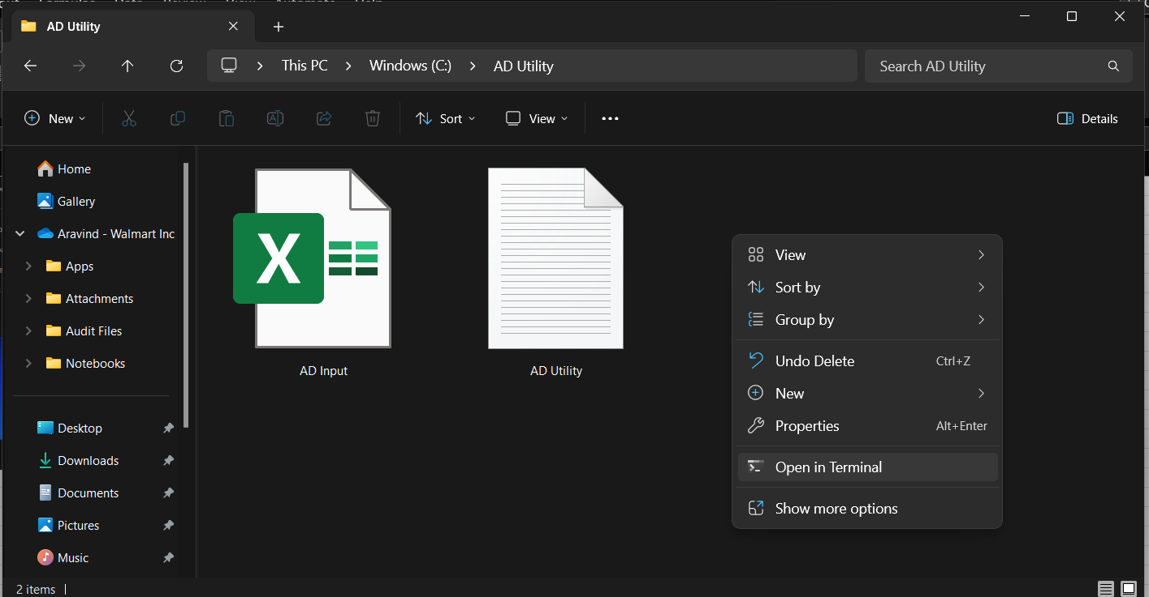
Execution
8. Go back to the folder where the 'AD Utility’ and ‘AD Input.xlsx' files are located. From here, right click to get a quick menu and click on the command ‘Open in Terminal’.

Slide 10
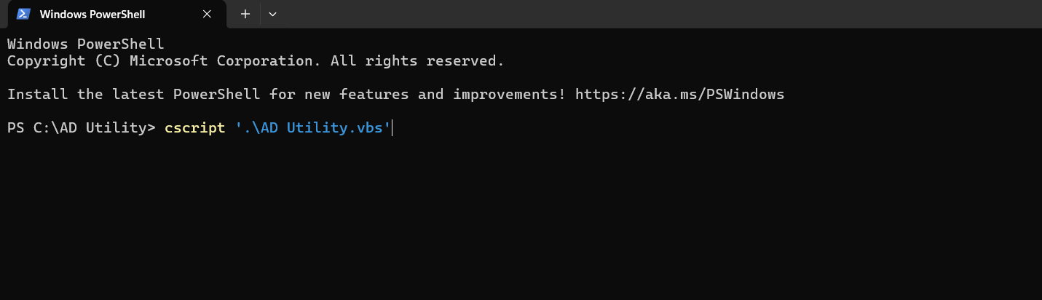
Execution
9. In the Terminal window, type and run the command
> cscript ‘.\AD Utility.vbs’
This command tells the script to use the accounts you entered in the ‘AD input.xlsx' file to perform the query and produce the result.

Slide 11
Output
10. Upon successful execution, the script delivers query results, clarifying whether the accounts listed in ‘User List’ tab of ‘AD Inputs.xlsx' are part of the specified Active Directory (AD) group or not.
11.You can confirm that the query is executed successfully by the statement ‘Command Executed Successfully on:’ with current date and timestamp.
12. The Query also displays:
Domain Name and AD groups the query is executed upon,
Number of input accounts,
List and Number of accounts belong to the AD group,
List and Number of accounts that does not belong to the AD group,
Date at which the query is executed.
13. This process automates the querying of multiple accounts in an AD group, eliminating the need for manual lookup saving a significant amount of time.
14. Refer to next page for the executed output of the query.

Slide 12
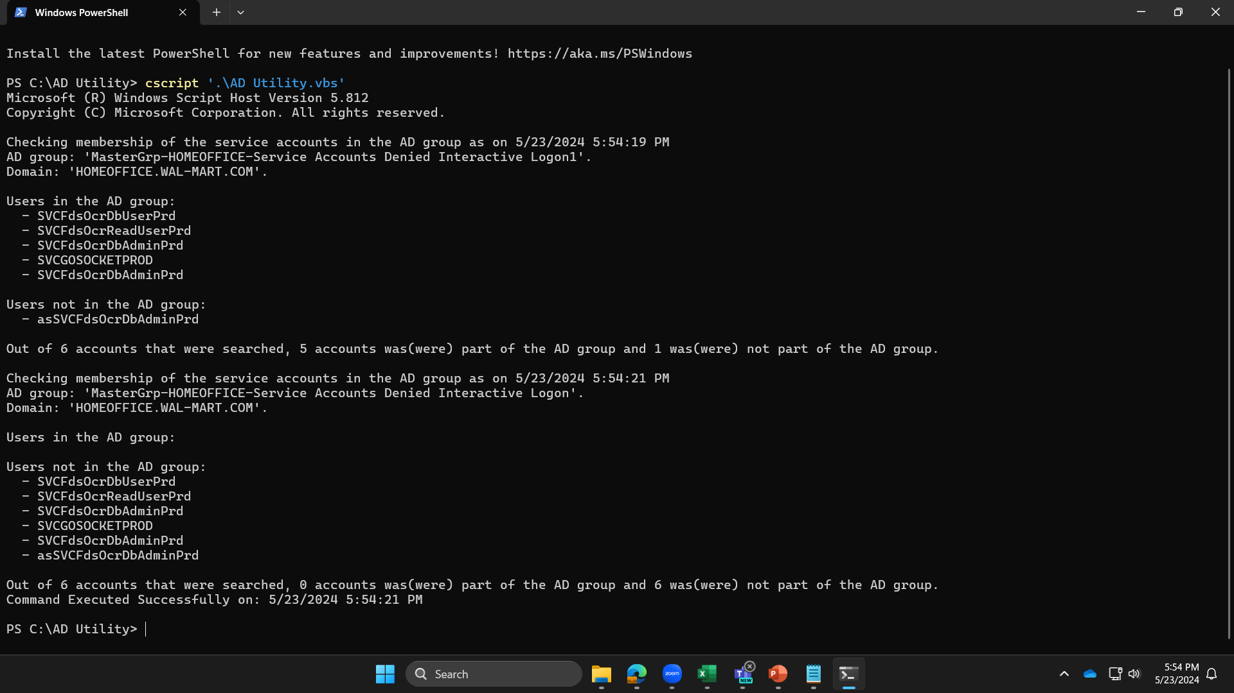
Output

